Slide 1
The Intersection of Prevention and Harm Reduction
Linda Brown, MPH
Overdose Prevention Coordinator
Infectious Disease Consultant

Slide 2
Objectives:
Review the goals of each level of prevention
Review the principals of harm reduction
Discuss the bi-directional nature of conditions
Upstream vs downstream approaches
Identify ways to balance funding streams and restrictions/limitations

Slide 3
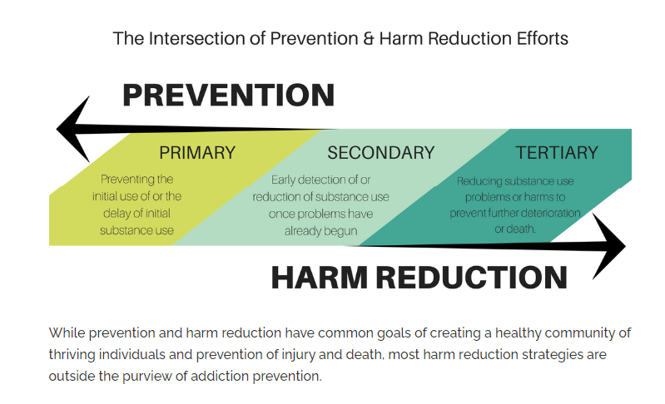
https://www.recoveryanswers.org/resource/drug-and-alcohol-harm-reduction/

Slide 4
Upstream vs downstream prevention:
You are a mayor of a town who near a swimming hole used by kids and adults. One summer you learn that that citizens are developing serious and persistent rashes after swimming because of a chemical irritant in the river.
If you approach the company upstream that is discharging the chemical into the river to make the discharge stop, that is primary prevention.
If you ask lifeguards to check swimmers as they get out of the river to look for signs of a rash that can be treated right away, you are engaging in secondary prevention.
If you set up programs and support groups that teach people how to live with their persistent rashes, you are engaging in tertiary prevention. Although you are not preventing rashes or dealing with them right away, you are softening their impact by helping people live with their rashes as best as possible.

Slide 5
Primary Prevention:
Approaches that aim to prevent disease conditions from developing by preventing exposures to hazards that cause disease or injury, altering unhealthy or unsafe behaviors that can lead to disease or injury and increasing resistance to disease or injury should exposure occur:
Ex: Education on the dangers that illicit drug use or tobacco use can have on individuals, families and communities; promotion of safe storage (ex. the provision of lock boxes or take back locations/events); promotion of on safe habits/behaviors and protective factors, etc.
Secondary Prevention:
Approaches that seek to identify a health condition that has already happened as early as possible to halt or slow its progression
Ex: Screening (ex. SBIRT) and referrals to clinical treatment to be prescribed medications to achieve the secondary prevention goal of identifying, diagnosing and treating OUD as early as possible.
Latimore, A. D., E. Salisbury-Afshar, N. Duff, E. Freiling, B. Kellett, R. D. Sullenger, A. Salman, and the Prevention, Treatment, and Recovery Services Working Group of the National Academy of Medicine’s Action Collaborative on Countering the U.S. Opioid Epidemic. 2023. Primary, secondary, and tertiary prevention of substance use disorder through sociological strategies. NAM Perspectives. Discussion Paper, National Academy of Medicine, Washington, DC. https://doi.org/10.31478/202309b.

Slide 6
Tertiary Prevention: Approaches that strive to minimize acute negative consequences, such as death, among those who have a disease, while promoting recovery and the management of long-term effects to improve overall well-being
Ex: providing overdose reversal agents to those persons using opioids or those using illicit substances that might be adulterated with opioids such as fentanyl to prevent death; raising awareness of good Samaritan laws, etc.
Latimore, A. D., E. Salisbury-Afshar, N. Duff, E. Freiling, B. Kellett, R. D. Sullenger, A. Salman, and the Prevention, Treatment, and Recovery Services Working Group of the National Academy of Medicine’s Action Collaborative on Countering the U.S. Opioid Epidemic. 2023. Primary, secondary, and tertiary prevention of substance use disorder through sociological strategies. NAM Perspectives. Discussion Paper, National Academy of Medicine, Washington, DC. https://doi.org/10.31478/202309b.

Slide 7
Harm Reduction: An approach that promotes health in a way that meets people where they are at, accepting that not everyone is ready or capable of stopping their substance use at any given time.
Instead of making judgments about where individuals suffering from addiction should be with regards to their health and behavior, harm reduction focuses on promoting evidence-based methods for reducing associated health risks in the current moment (e.g., preventing HIV transmission).
The defining features of harm reduction include a focus on the prevention of harm, rather than on the prevention of substance use itself.
Harm reduction initiatives run the gamut from medical care and disease prevention, to education and linkage to addiction treatment.
https://www.recoveryanswers.org/resource/drug-and-alcohol-harm-reduction/

Slide 8
PRINCIPLES OF HARM REDUCTION:
Non-judgmental approach that meets people where they are at
Treating all individuals with dignity, compassion, and respect
Opposition to the stigmatization of substance use disorder
Use of evidence-based policy and practice
Accepting behavior change as an incremental process.
Small gains for many people have more benefit for a community than large heroic gains achieved for a select few. People are much more likely to take multiple tiny steps, rather than one or two huge steps
Inclusion of individuals in active addiction, in recovery, and within the community to shape policies and practices
Focus on quality life improvements over abstinence
Commitment to universal human rights
Empowerment of the individual as the primary agent responsible for reducing the harms related to their substance use
https://www.recoveryanswers.org/resource/drug-and-alcohol-harm-reduction/

Slide 9
Misconceptions include that harm reduction strategies and programs:
Enable illicit drug use
Condone illicit drug use
NIMBY (Not In My Backyard) attitudes that fear harm reduction programs will increase substance use and crime in the surrounding communities (although this fear is not supported by research).
https://www.recoveryanswers.org/resource/drug-and-alcohol-harm-reduction/

Slide 10
Because you may have contact with citizens and clients experiencing varying stages of substance use, it is often necessary to promote and advocate for health-promoting secondary and tertiary approaches while conducting primary prevention in your work.
DAODAS understands however, that sometimes the practical implementation of your projects may be affected by staffing resources, funding stream limitations, and other demands, etc.
So, let’s discuss some scenarios of activities to identify when the delivery of primary prevention can seem to overlay with the delivery of secondary and/or tertiary prevention activities. Then let’s share innovative strategies that sites have put into place to circumvent the confusion.

Slide 11
Scenario 1:
Your executive director asks you to organize a health fair for the community. At the health fair, the agency has made available: Deterra, prevention pamphlets and brochures, overdose reversal agents (ORA), FTS with instructional pamphlets and a list of SUD treatment and recovery services provided by the agency.
You are funded 100% by the primary prevention block grant. In the above scenario, what are the primary prevention items that you can distribute to the public?
Scenario 2:
You are asked to conduct a speaking engagement on current drug trends. Your ORA team lead hears that the area you are going into has been shown on ODMAP to be a current “hotspot” for overdose alerts. She asks if you would consider also discussing how to respond to an overdose and hand out some ORA at the end of the session so that they can count that as a distribution event toward their saturation plan benchmark numbers.
You are funded 90% primary Prev block grant and 10% (local county funding). Is this request one that is appropriate for you?

Slide 12
Scenario 3:
You are funded 95% with the primary prevention block grant and 5% with local county funds. You have been asked to assist with naloxone distribution events outside of normal business hours. The agency is providing you with a contract to work up to 10 hours each month to assist with ORA distribution events in “hotspot” locations throughout the county that they will determine through ODMAP. Is it okay for you to provide this service?

Slide 13
1801 Main Street, 12th Floor • Columbia, SC 29201
telephone: 803-896-5555 • fax: 803-896-5557
www.daodas.sc.gov
Linda Brown
lbrown@daodas.sc.gov
Phone: 803-896-7387
Notes:
Final Slide

